Slide 1
Debate
Terms and Tactics

Slide 2
Terms
Affirmative (AFF): To argue for the resolution
Negative (NEG): to argue against the resolution
Flow: To jot notes on a speaker’s argument structure, claims, and evidences

Slide 3
Terms
Counter-Argument/rebuttal: a claim that challenges one from the opposing side
Resolution: The affirmative position of an argument

Slide 4
Rhetorical Tactics
Rule of thirds: list statements in sets of three
“of the people, by the people, for the people”
Alliteration: list of words that begin with the same letter/sound
(live, laugh, love/equip, engage, inspire)
Repetition: to say the same word or phrase over and over i.e. “We are tired”

Slide 5
Rhetorical Tactics
Appeal to authority: point to an authority to back up one’s argument
Validity/logic: how true a claim is; thinking reasonably; the argument makes sense
Sound: Both true and valid
Appeal to emotion: Using words or phrases to evoke emotion

Slide 6
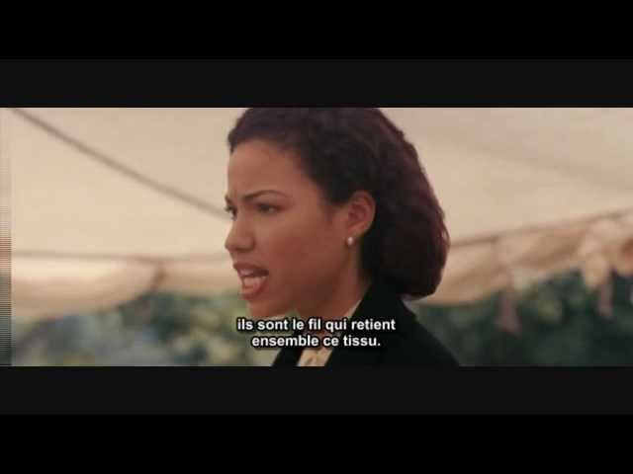
Let’s see how it works!

Slide 7
Video Questions
What rhetorical strategies did you see used in the debate?
Did you hear the word “Resolved” during her speech? When?
When did she use repetition? Was it effective? Why or why not?
Did you hear a counter-argument? When?

Slide 8
How to Flow~
Prep your paper:
C - write the claim you identify here
R- (reasoning) how this E connects to claim)
E 1 - write evidence #1 here
E 2- write for evidence #2 here
E3- write for evidence #3
S- how the speaker intends to fix the problem

Slide 9
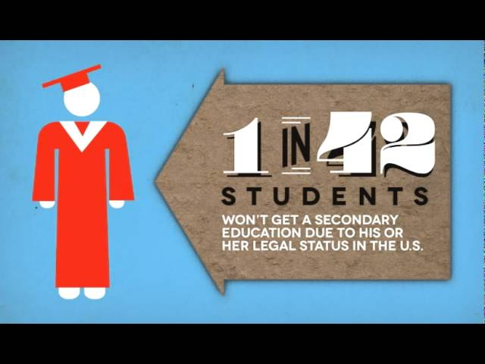
Let’s Practice Flowing!

Slide 10
Video Questions
What is the main claim made in the video?
What are some evidences the speaker uses to defend his claim?
How does this speaker address counter arguments?
What did you like/dislike about this video?

Slide 11
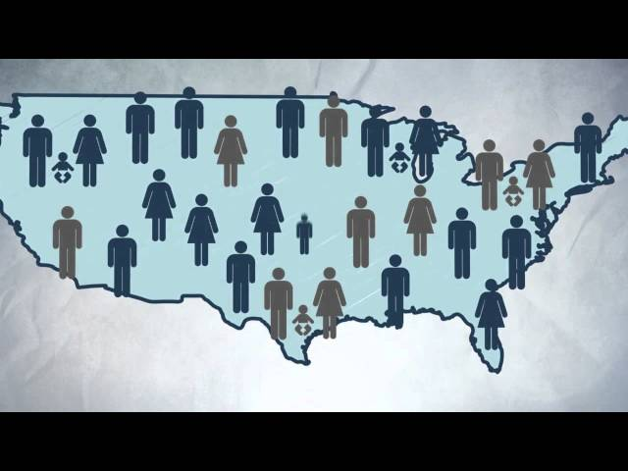
Ready, Set, Flow!

Slide 12
Video Questions
What is the main claim made in the video?
What are some evidences the speaker uses to defend his claim?
How does this speaker address counter arguments?
What did you like/dislike about this video?

